Slide 1
User guide
Fee form
Sist oppdatert: 09.11.2023

Slide 2
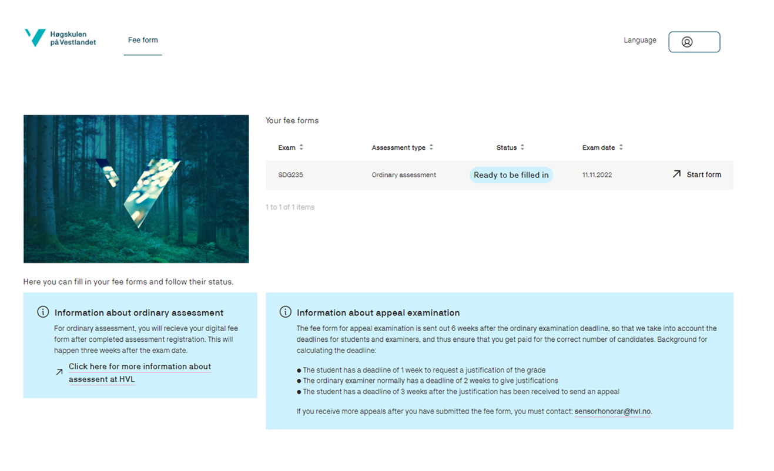

Slide 3
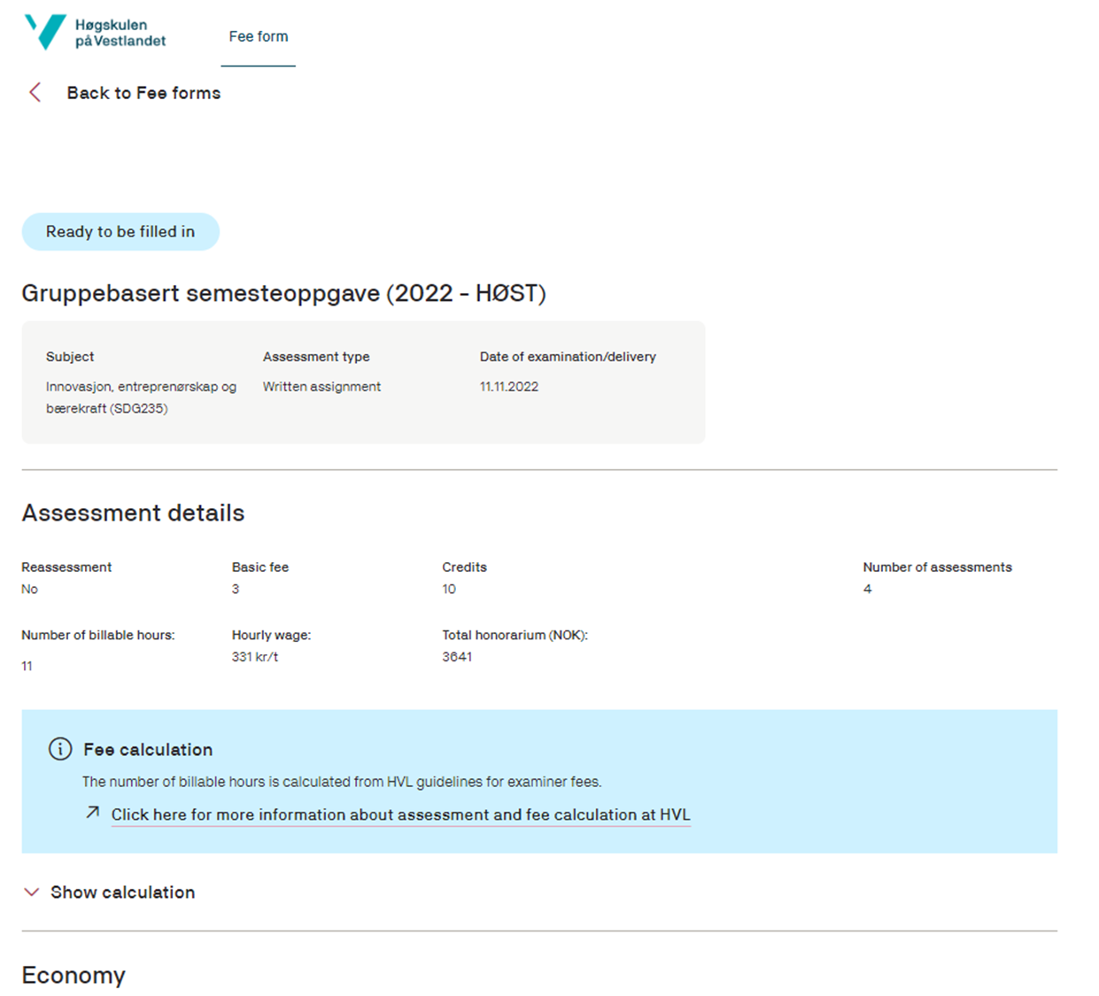
Display of prefilled details with possibility of showing calculation.

Slide 4
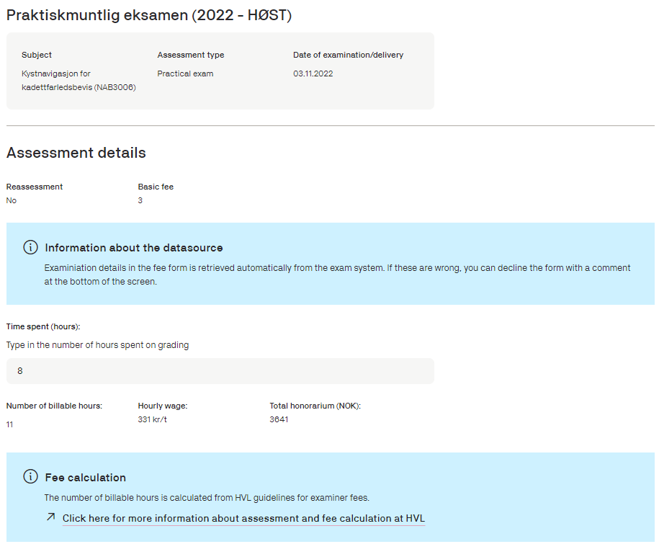
For practical exams and portifolio assessment, the time spent must be filled in.

Slide 5
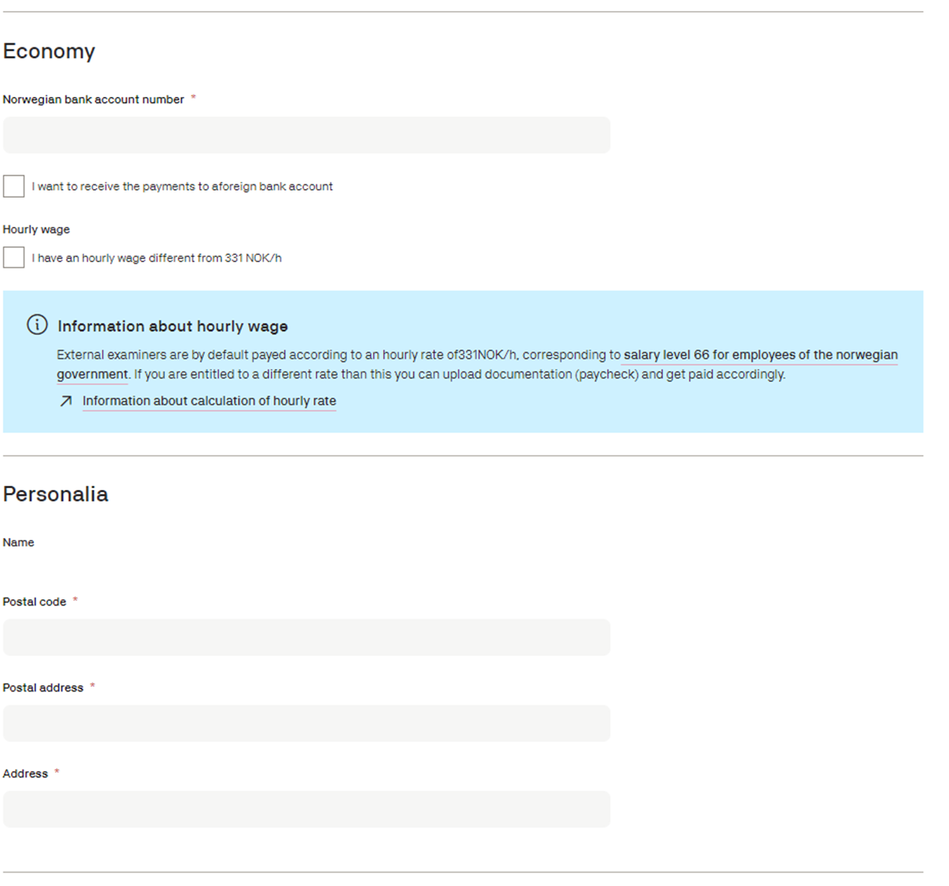
Economy and personalia

Slide 6
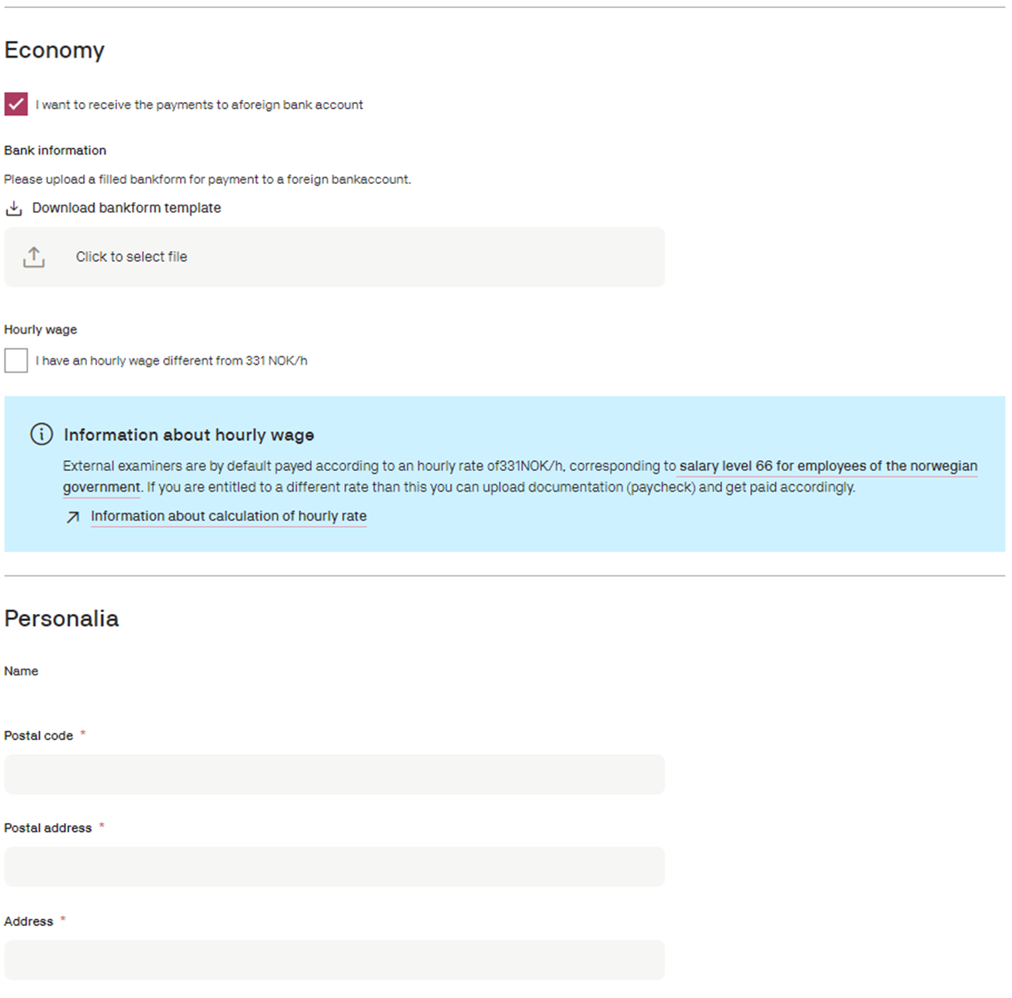
If the user chooses foreign bank account, a bank detail form must be filled out and uploaded to the application.

Slide 7
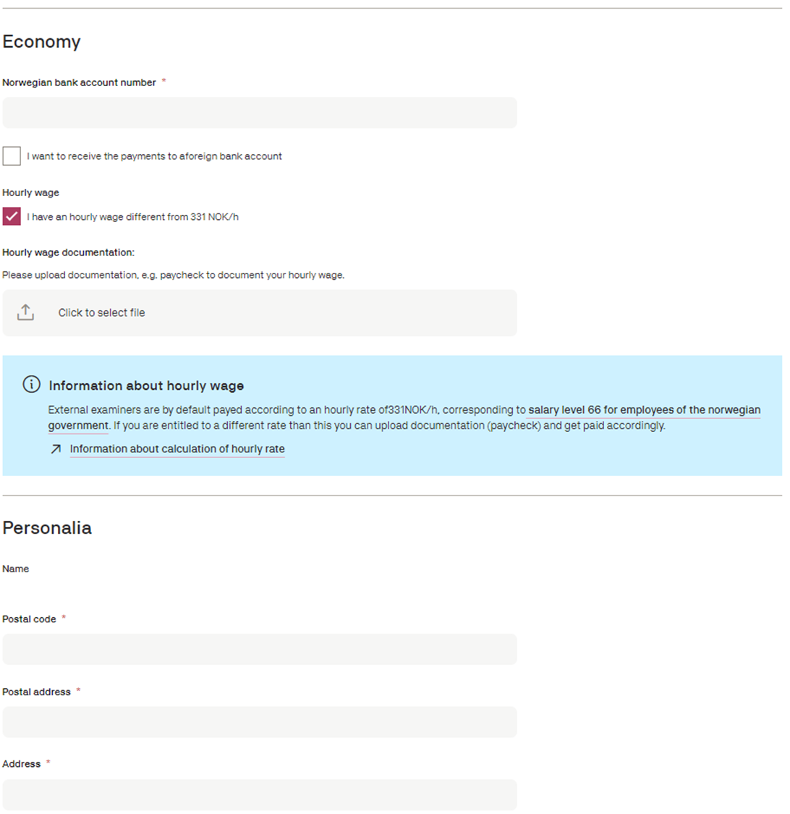
When choosing «I have an hourly wage different from 331 NOK/h», documentation must be uploaded.
The standard hourly rate is set to 331 NOK/h, but can be adjusted if needed.

Slide 8
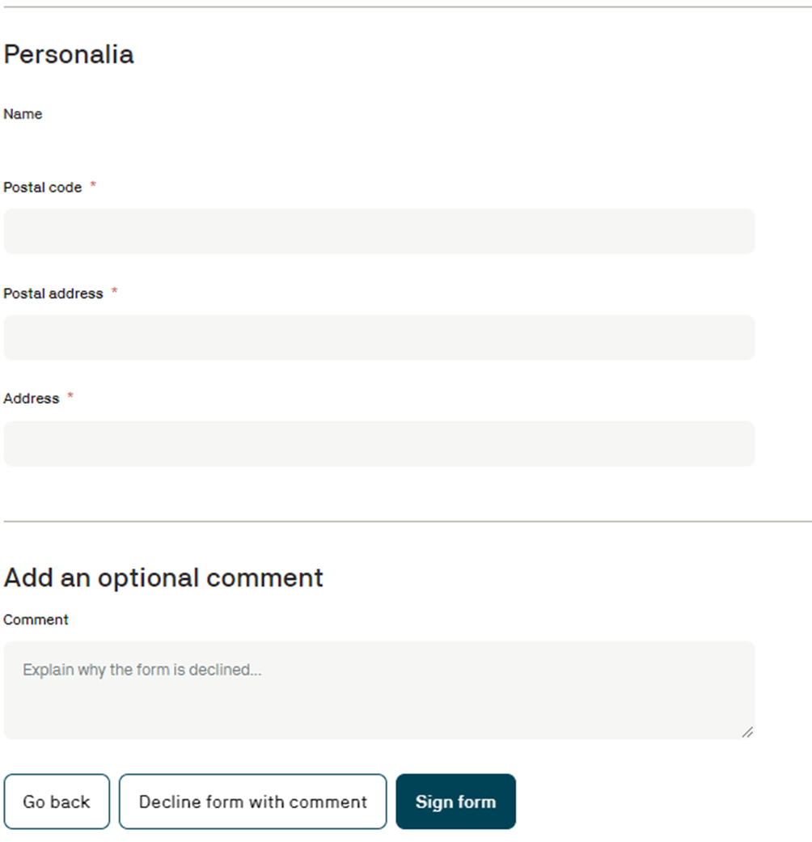
The sensor can add an optional comment. It will be shown when viewing the form in Sensorportalen

Slide 9
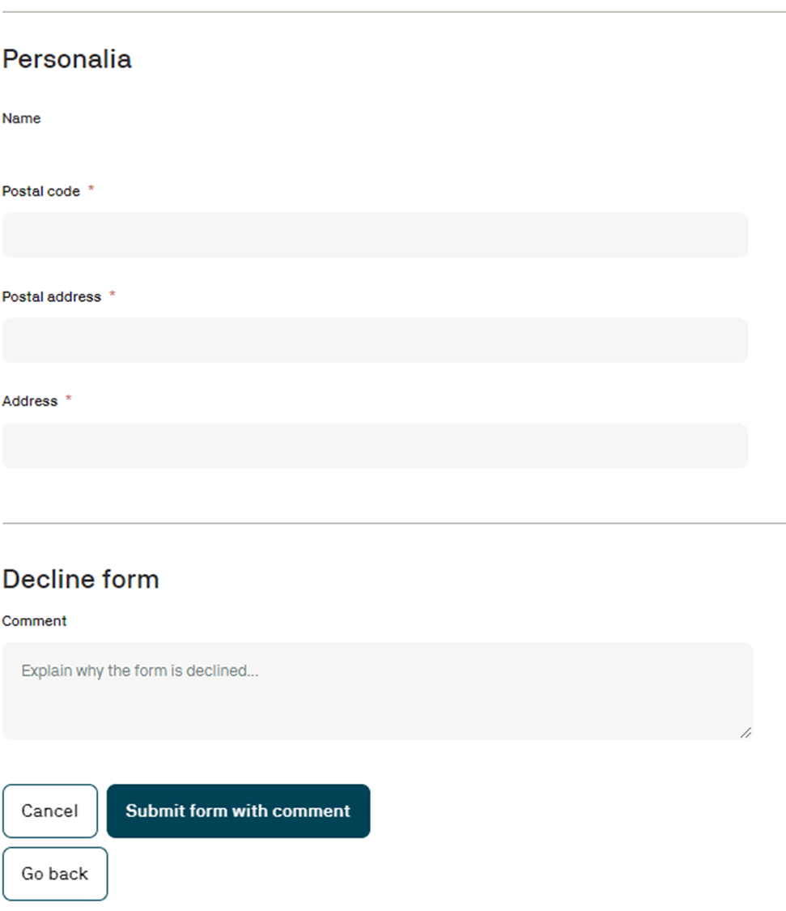
When declining the form, a comment is mandatory.
To decline the form, the user must press «Decline form with comment» (see previous slide)
By pressing «Submit form with comment», the form’s status is changed to «Declined» in Sensorportalen. No signature is needed when declining a form.

Slide 10
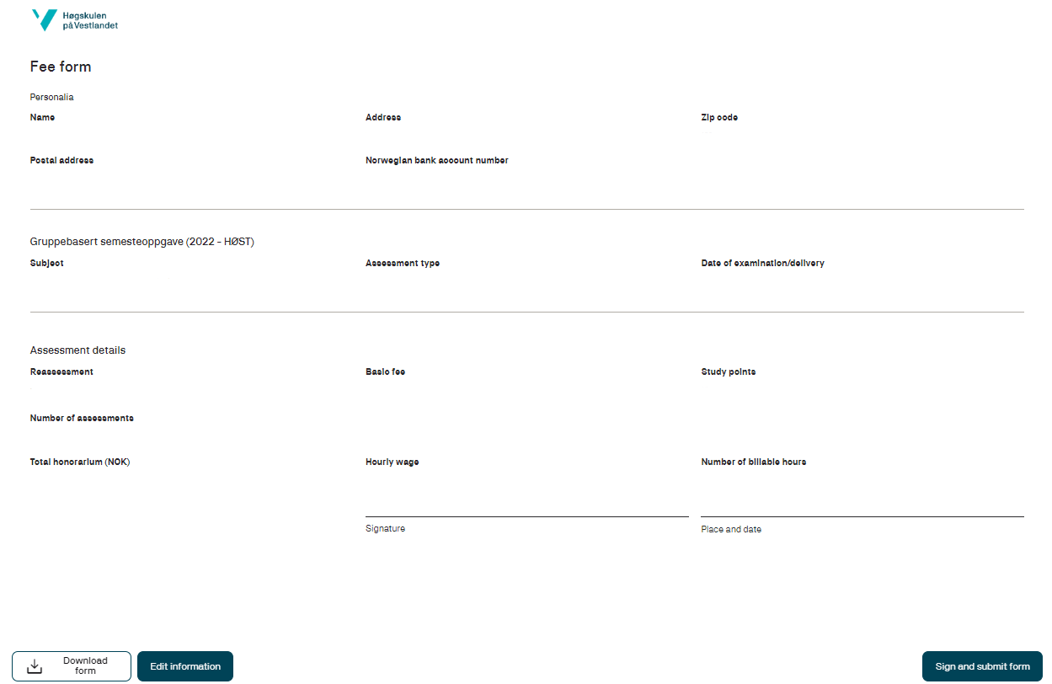
Signing the form as person with a Norwegian social security number.
By pressing «Sign and submit form», the user is sent to a site for digital signing.

Slide 11
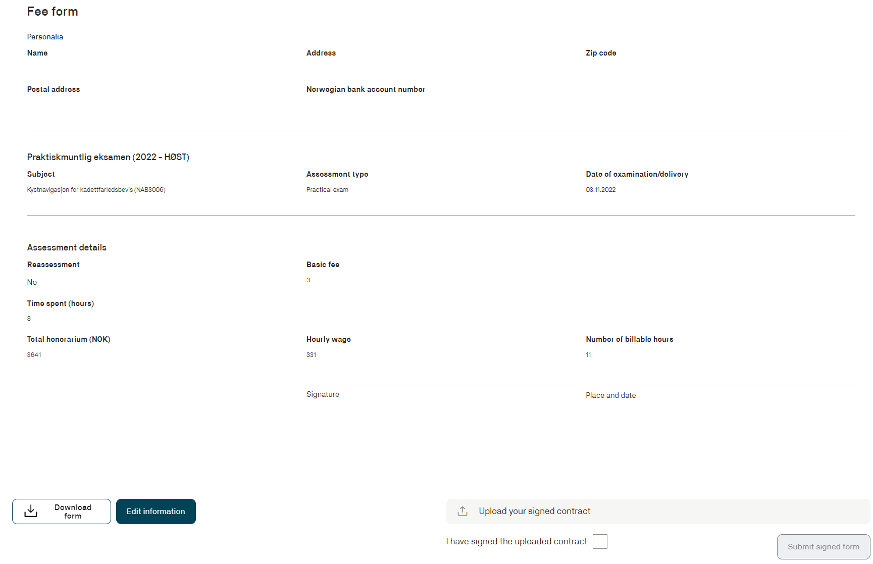
Signing the form as person without a Norwegian social security number
The form must be downloaded, and its signed version must be uploaded

Slide 12
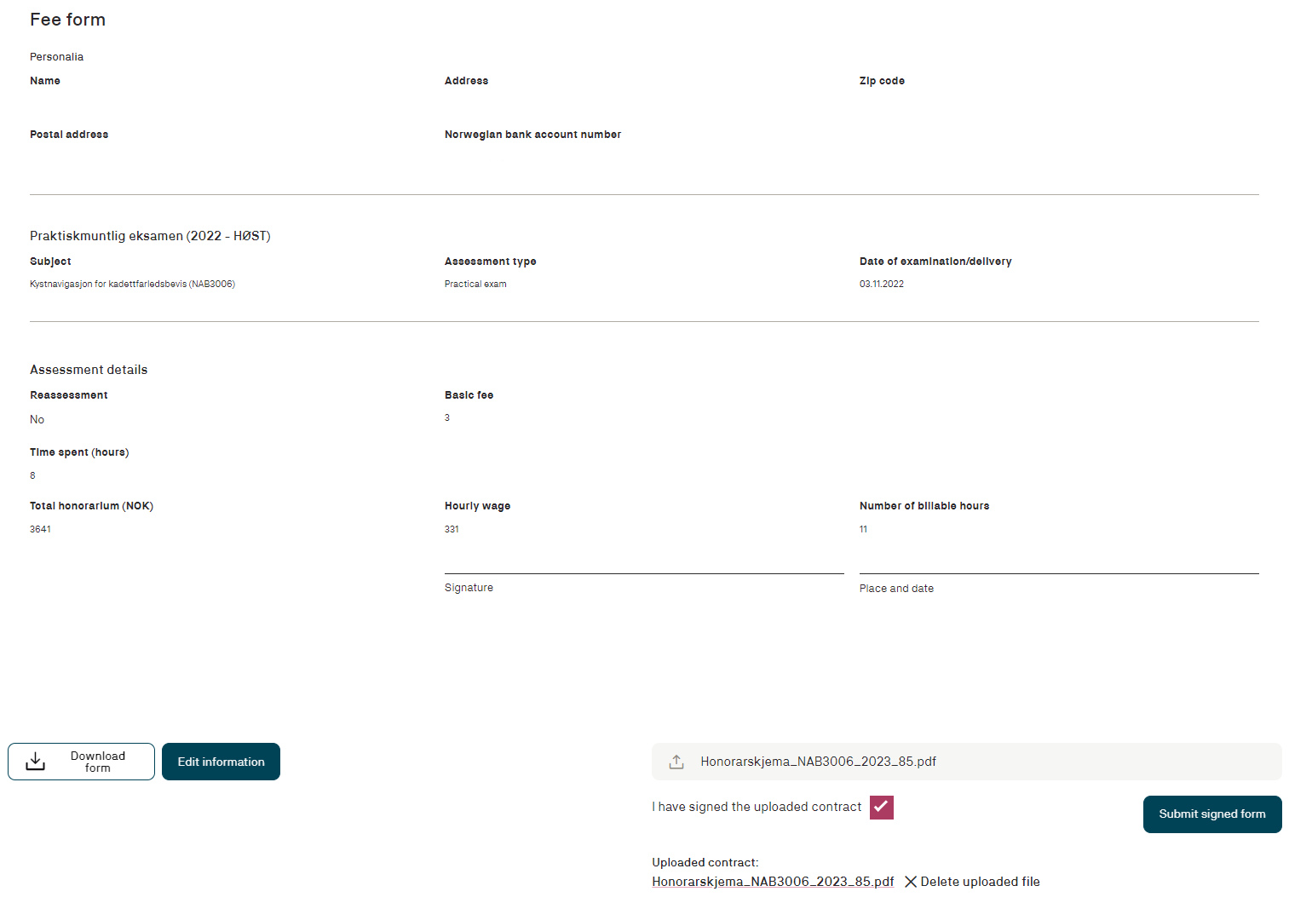
Signing the form as a person without a Norwegian social security number
The form must be downloaded, and its signed version must be uploaded

Slide 13
